Slide 1

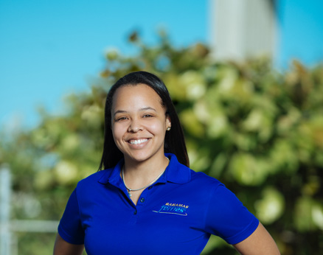
We Are Hiring!
RECEPTIONIST
Documents and General Requirements
Resume
Government Issued Identification
High School Diploma
Police Record
The candidate must be courteous, reliable and professional. Must have good communication and computer skills, be able to multi-task and follow instructions.
This is an entry level position.
Resumes and supporting documents must be sent via email to: hr@bahamasferries.com

